Slide 1
DATABASE PRESENTATION umar sudais

Slide 2
Forms, Reports and Relationship between Tables

Slide 3
OUTCOMES:
Forms
Relationships
Keys
Different types of Relationships

Slide 4
FORMS
Forms in Microsoft Access provide user-friendly interfaces for data entry, customization, and navigation within a database.
They enforce data accuracy, validate input, and improve the user experience.
Forms make it simple to organize and manage data.
You can add buttons and stuff to make your database work better.

Slide 5
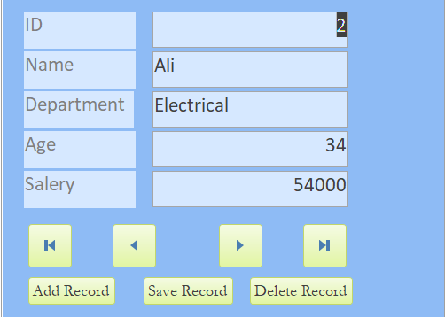
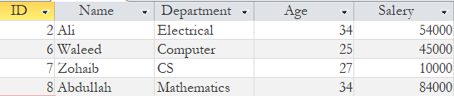
FORMS

Slide 6
RELATIONSHIP:
Relationships in MS Access establish connections between tables to organize and link data.
They ensure data accuracy, simplify queries, and prevent data duplication.
Relationships ensure data accuracy, help create reports easily, and make data easier to handle.
Can be complex to set up and may require careful maintenance.

Slide 7
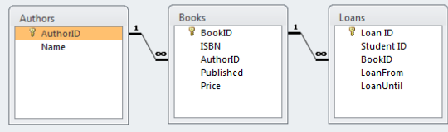
RELATIONSHIP:

Slide 8
KEYS
Following are different types of keys:
Primary Key:
A primary key is a unique identifier for each record within a table.
It ensures that no two records in the same table have the same value in the primary key field.
Foreign Key:
A foreign key is a field in one table that is used to establish a relationship with the primary key in another table.
It links data between related tables, allowing you to retrieve information from multiple tables based on common values.

Slide 9
ONE-TO-ONE
Each record in the primary table corresponds to exactly one record in the related table.
One-to-one relationships can help optimize database performance by reducing the size of the main table.
One-to-one relationships can add complexity to the database design.

Slide 10
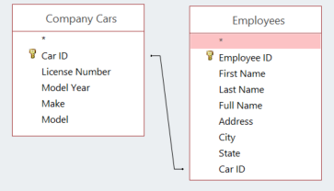
ONE-TO-ONE

Slide 11
ONE-TO-MANY
A one-to-many relationship in MS Access links records in two tables, where each record in the primary table corresponds to one or more records in the related table.
They provide a structured way to organize and manage data, making it easier to query and report on related information.
Often used for scenarios like customers and their orders, where one customer can have multiple orders.

Slide 12
MANY-TO-MANY
A many-to-many relationship in MS Access links records in two tables where multiple records in one table can be associated with multiple records in the other table.
It often involves an intermediate or junction table that holds pairs of related records.
Students and courses, where each student can enroll in multiple courses, and each course can have multiple students are good examples of many-to-many relationship.

